Slide 1
Adaptive Signal Processing
Date: - 20th April 2022
By: - Abhinav Mahajan, IMT2020553.

Slide 2
Contents: -
Introduction: -
The gist and need for Adaptive signal processing
Wiener filter and Adaptive filters.
Applications of adaptive filters.
Adaptive Filter Algorithms: -
Introduction to prediction modelling and algorithmic approach.
Gradient Descent and Steep gradient descent.
Least Mean Squared (LMS) algorithm.
Recursive Least Squared (RLS) algorithm.
Conclusion

Slide 3
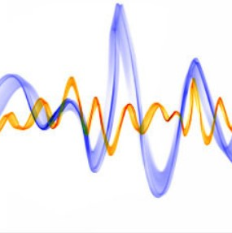
So what is Adaptive Signal Processing?
It is the design, analysis, and implementation of systems whose structure changes in response to the incoming data.

Slide 4
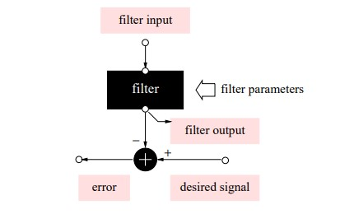
Wiener filter
A prototype of Wiener Filter

Slide 5
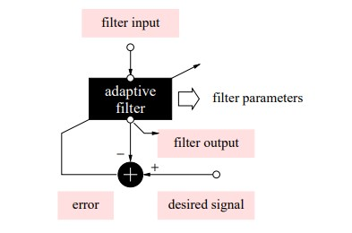
Adaptive Filter
A prototypical Adaptive Filter

Slide 6
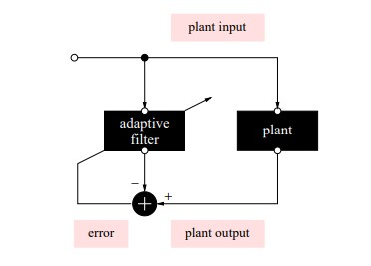
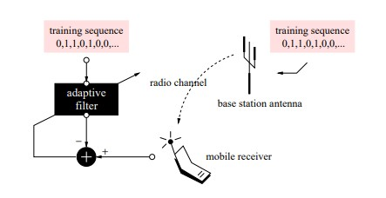
Application in Identification Systems
Lets take the example of a radio channel identifier: -
Scheme for Identification
Channel Identification in Mobile

Slide 7
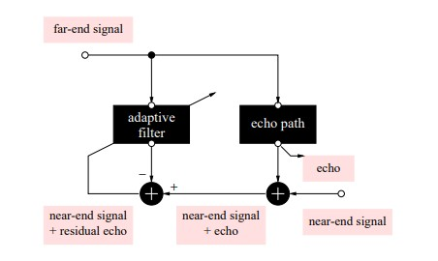
Echo Removal
Scheme for Echo Cancellation

Slide 8
Some other applications are: -
Noise and Interference Cancellation
Inverse Modelling
Linear Prediction

Slide 9
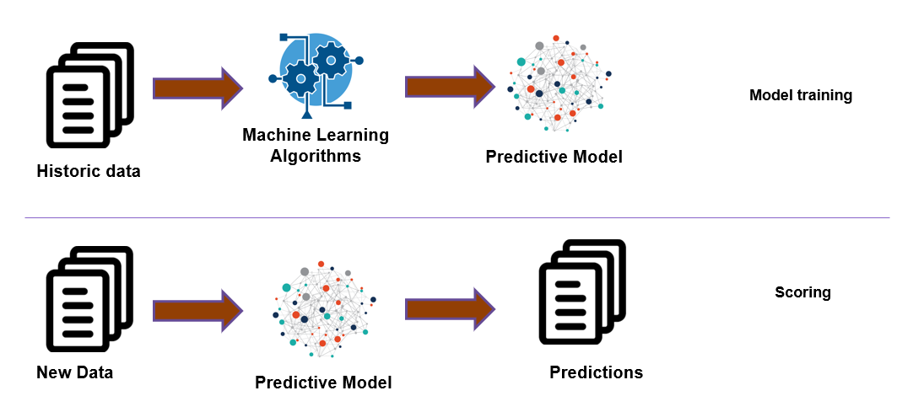
Prediction Modelling
It is the most important and fundamental aspect in the evolution of Machine Learning and Artificial Intelligence.
Linear Regression is the tool we use to study data and model predictions.
Machine Learning in a nutshell

Slide 10
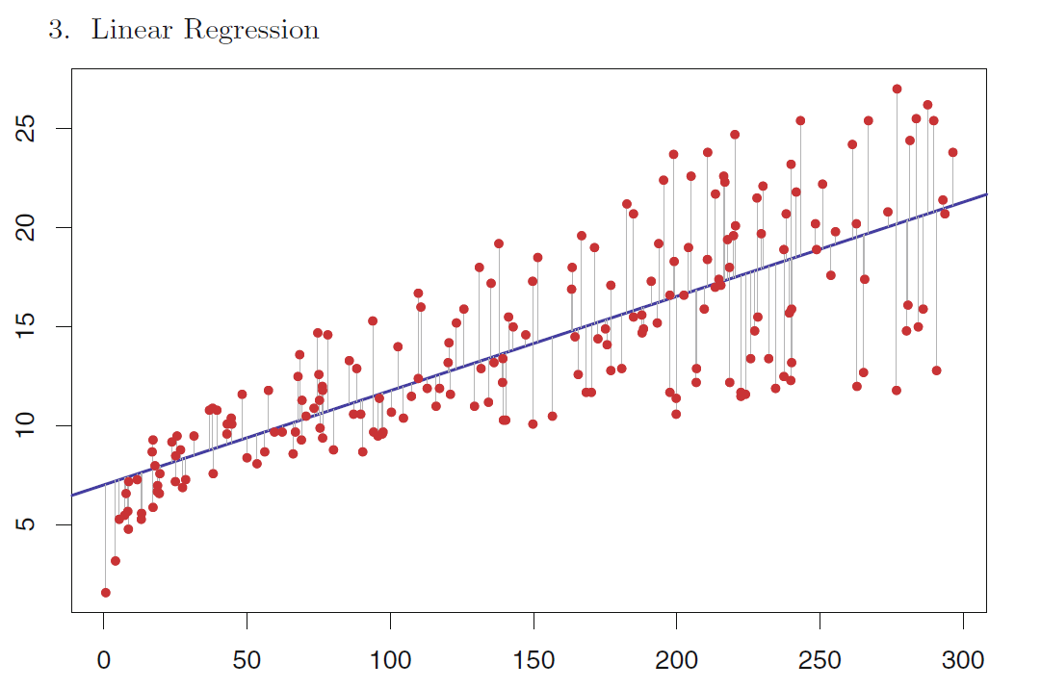
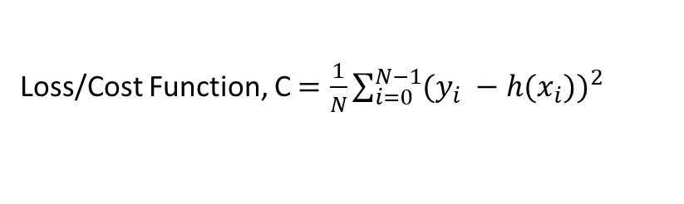
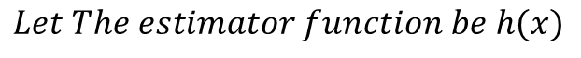
$$Let The estimator function be h(x)$$
Loss/Cost Function, C$=\frac{1}{N}\sum_{i=0}^{N−1}{({y_{i} −h(x_{i}))}^{2}}$
Now to find an estimator/predictor function for our data, all we need to do is minimise the Cost function!

Slide 11
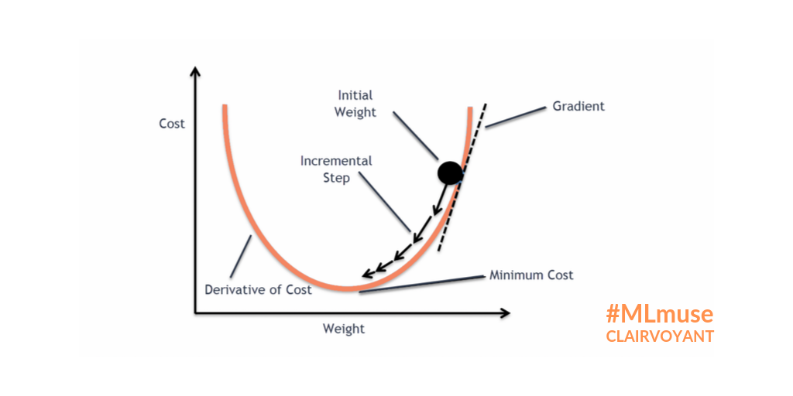
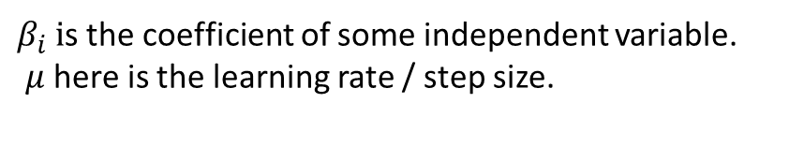

Gradient Descent Method
$$β_{i}=β_{i}− μ\frac{∂C}{∂β_{i}}$$
$β_{i} i$s the coefficient of some independent variable.
$μ$ here is the learning rate / step size.

Slide 12
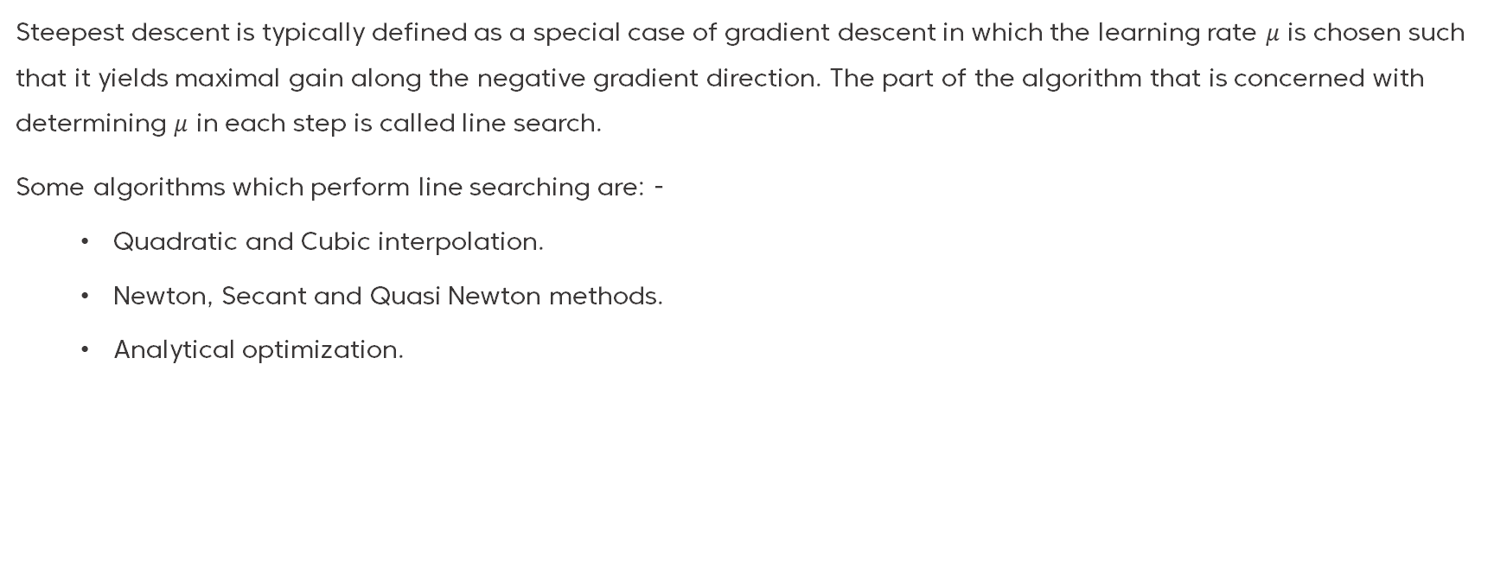
Steepest Descent Method
Steepest descent is typically defined as a special case of gradient descent in which the learning rate $μ$ is chosen such that it yields maximal gain along the negative gradient direction. The part of the algorithm that is concerned with determining $μ$ in each step is called line search.
Some algorithms which perform line searching are: -
Quadratic and Cubic interpolation.
Newton, Secant and Quasi Newton methods.
Analytical optimization.

Slide 13
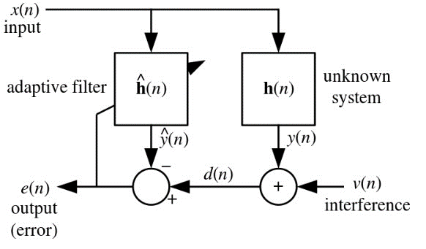
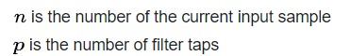
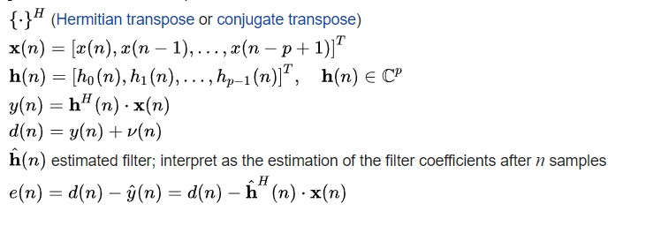
Adaptive Filter variables

Slide 14
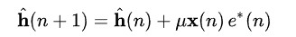
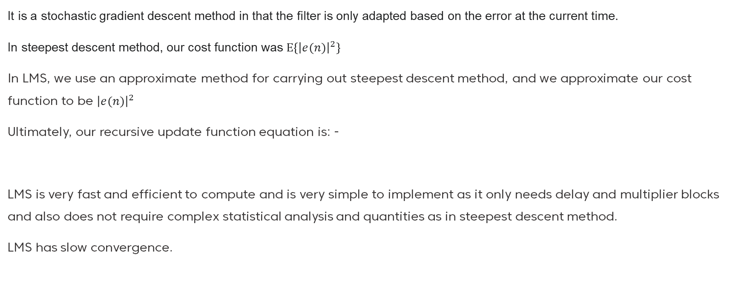
Least Mean Squared (LMS) Algorithm
It is a stochastic gradient descent method in that the filter is only adapted based on the error at the current time.
In steepest descent method, our cost function was $E\left\{{\left|e(n)\right|}^{2}\right\}$
In LMS, we use an approximate method for carrying out steepest descent method, and we approximate our cost function to be ${\left|e(n)\right|}^{2}$
Ultimately, our recursive update function equation is: -
LMS is very fast and efficient to compute and is very simple to implement as it only needs delay and multiplier blocks and also does not require complex statistical analysis and quantities as in steepest descent method.
LMS has slow convergence.

Slide 15
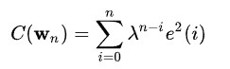
Recursive Least Squared (RLS) Algorithm
RLS is an adaptive filter algorithm that recursively finds the coefficients that minimize a weighted linear least squares cost function relating to the input signals. This approach is in contrast to other algorithms such as LMS, that aim to reduce the mean square error.
The updated cost function is: -
RLS has the highest capacity for noise cancellation, and also has the fastest convergence.
RLS however requires a lot of complex statistical analysis tools and quantities as well as electronic hardware.

Slide 16
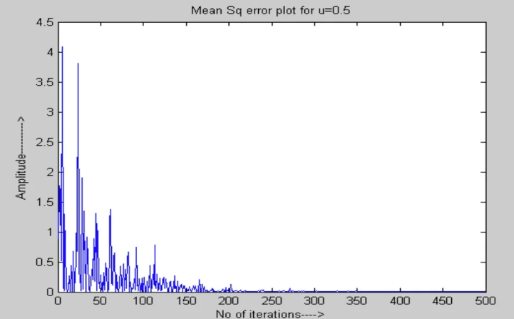
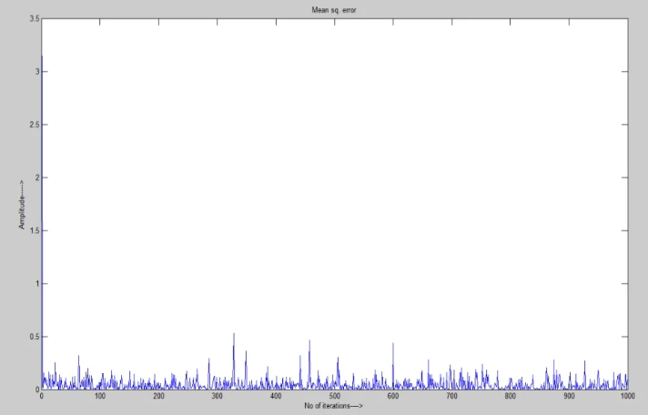
Rate of Convergence of LMS
Rate of Convergence of RLS

Slide 17
Conclusion
To deal with real life, non-stationary and dynamic data, Adaptive filters and technologies need to be used and it cannot be substituted.
Future applications in the medical, communication fields etc.
Computational complexity of the most accurate algorithms is very high, A lot of scope lies in optimising the algorithms and increasing its accuracy and decreasing the hardware and statistical complexity.

Slide 18

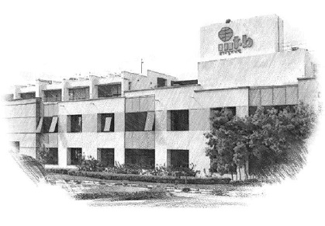






International Institute of Information Technology Bangalore
26/C, Electronics City, Hosur Road,
Bengaluru – 560 100, Karnataka, India
www.iiitb.ac.in
https://www.facebook.com/IIITBofficial/
https://twitter.com/IIITB_official
https://www.linkedin.com/school/iiit-bangalore/
https://www.youtube.com/user/iiitbmedia
https://www.instagram.com/iiitb_official/

